Slide 1


Intelligence d’affaires Intro BI and Business strategy
Titre du cours : Intelligence d'affaires: principes et méthodes 2025

Slide 2
Agenda
Intro BI and Business strategy
Exemple; BI

Slide 3
Objectifs du cours Intro BI and Business strategy
Objectifs:
Définir l’intelligence d’affaires
Les éléments qui composent l’intelligence d’affaires (BI)
Définition de stratégie
Exemple de faire de l’intelligence d’affaires (BI)

Slide 4
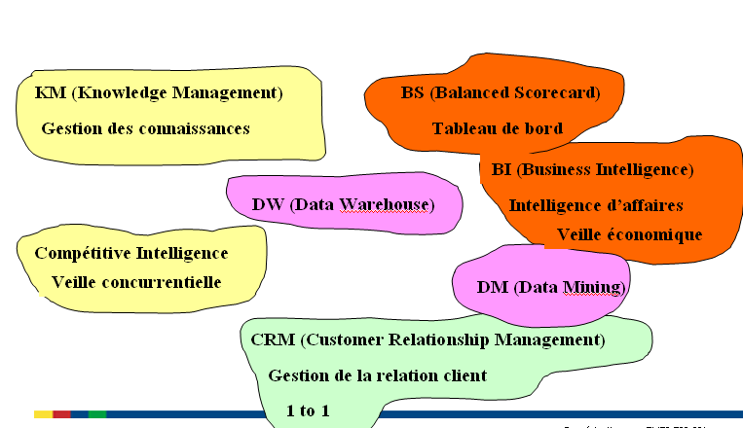
Introduction
Intelligence d’affaires ….une tour de Babel?
Information structurée versus non-structurée
Intelligence artificielle
Big data
Hadoop

Slide 5
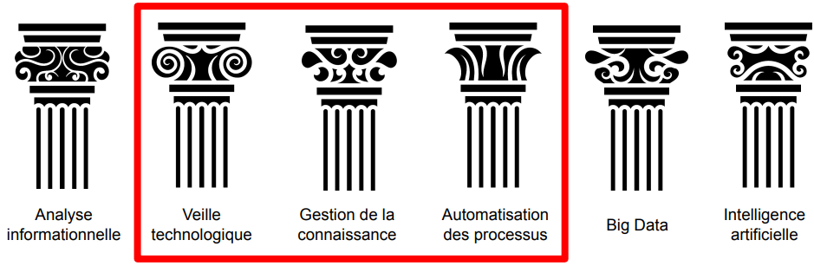
Intelligence d’affaires
Liés
L’analyse informationnelle (tableau de bord)
La veille stratégique, technologique et concurrentiel
La gestion de la connaissance (KM)
Automatisation des processus ( algorithme)
+ dernièrement le phénomème Big DATA
+ dernièrement l’Intelligence artificielle
Aligné avec le plan d’affaire

Slide 6
Définition
Intelligence d’affaires - Business Intelligence (BI)
Un ensemble de concepts, de méthodologies et d’application pour rassembler, stocker, analyser et permettre d’accéder à des données dans le but d’aider les utilisateurs d’entreprises dans leur processus d’affaires.
Permet de transformer:
Les données en information
Les informations en connaissances
Les connaissances en stratégies menant à des actions profitables à l’entreprise.

Slide 7
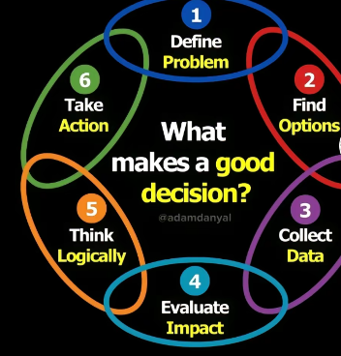
Intelligence d’affaires - Business Intelligence (BI)

Slide 8
Business Intelligence and Information Management initiative leaders are faced with the following challenge: Enterprises have invested billions of dollars to create and manage information, but workers and managers still can't get the right information at the right time to make good decisions and improve business performance. In other ways, the economic conditions brought a renaissance of thinking and activity regarding information — as enterprises realized that many of their cost and risk issues resulted from poor information management and business decision practices.
Breaking down business, information and technology silos to better exploit information assets to make better decisions and improve business performance requires a strategic approach.
Our 202X research will focus primarily on providing guidance to help clients devise and execute such strategies.–
Bill Hostman, VP Distinguished Analyst, Gartner Research

Slide 9
Exemples Site web Classe Mondiale
I
Gartner | Delivering Actionable, Objective Insight to Executives and Their Teams
Pour IT
Digital consulting | McKinsey & Company
https://www.mckinsey.com/
Pour les affaires

Slide 10
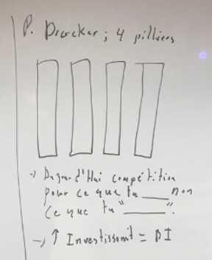
Peter Drucker a écrit 36 livres : 15 sur le management dont les 2 célèbres The Practice of Management (traduit :) et The Effective Executive
4 pilliers
Ressouces humaines
Ressources financières
Ressources matériels (actifs)
Ressources Informationnelles
Les entreprises compétitions pour ce qu’elles connaissent non pas pour ce qu’elles possèdent

Slide 11
Peter Drucker a écrit 36 livres : 15 sur le management dont les 2 célèbres The Practice of Management (traduit :) et The Effective Executive

Slide 12
http://www.techno-science.net/
La stratégie - du grec stratos qui signifie « armée » et ageîn qui signifie « conduire » - est :
l'art de coordonner l'action de l' des forces de la Nation - politiques, militaires, économiques, financières, morales… - pour conduire une guerre, gérer une crise ou préserver la paix, «La stratégie est de la compétence du gouvernement et de celle du haut-commandement des forces armées.» Charles de Gaulle
La stratégie consiste à la définition d'actions cohérentes intervenant selon une logique séquentielle pour réaliser ou pour atteindre un ou des objectifs. Elle se traduit ensuite, au niveau opérationnel en plans d'actions par domaines et par périodes, y compris éventuellement des plans alternatifs utilisables en cas d'évènements changeant fortement la situation.
En contraste à la tactique dont l'enjeu est local et limité dans le (gagner des combats à l'intérieur d'une bataille), la stratégie à un objectif global et à plus long terme (gagner la bataille à l'intérieur d'une guerre qui est du ressort de la politique). En effet, il appartient à la politique le choix de la paix ou de la guerre et l'attribution des ressources mises en œuvre par des stratégies militaires sur le champ de bataille ou diplomatiques dans des négociations
En fait, les militaires considèrent, dans cet art de combiner ses moyens et ses ressources en fonction des contingences, trois niveaux :
le niveau stratégique, ou plus couramment aujourd'hui politico-militaire, au plus haut niveau de l'État, dans un dialogue itératif entre responsables politiques, diplomatiques et militaires ;
le niveau tactique, entre le haut-commandement militaire et le commandant d'un théâtre d'opération ;
le niveau opérationnel, qui est celui, local, du commandant d'unité engagé dans une action particulière

Slide 13

Michael Porter - Big Ideas
- Strategy is about making choices, trade-offs; it's about deliberatly
choosing to be different.
- A strategy delineates a territory in wich a company seeks to be unique.
Strategy 101 is about choices: You can't be all things to all people.
- The essence of strategy is that you must set limits on what you're
trying to accomplish.
Technology changes, strategy doesn't
- The underlying principles of strategy are enduring, regardless of technology or
the pace of change.
Strategy hasn't change, but change has
- On the other hand, I agree that the half-life of everything has shortened.
setting strategy has become a little more complicated. In the old days, maybe 20
years ago, you could set a direction for your
Great strategies are a cause
-The best CEOs I know are teachers and at the core of what teach is strategy. They
go out to employees, to suppliers, and to customers, and they repeat, “ This is what
we stand for, this is what we stand for .” So everyone understands it.
This is what leaders do.
March 2001

Slide 14
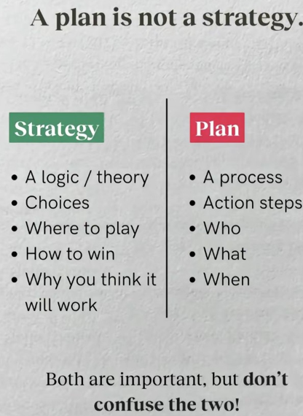

Slide 15
Recherche sur Gartner pour effectuer de l’Intelligence Affaires
Exemple …
Je suis, vous êtes CIO d’une entreprise !
Votre role ?
En grande partie faire de l’Intelligence Affaires
Gartner's CIO Survey Provides Keys of BI informations

Slide 16
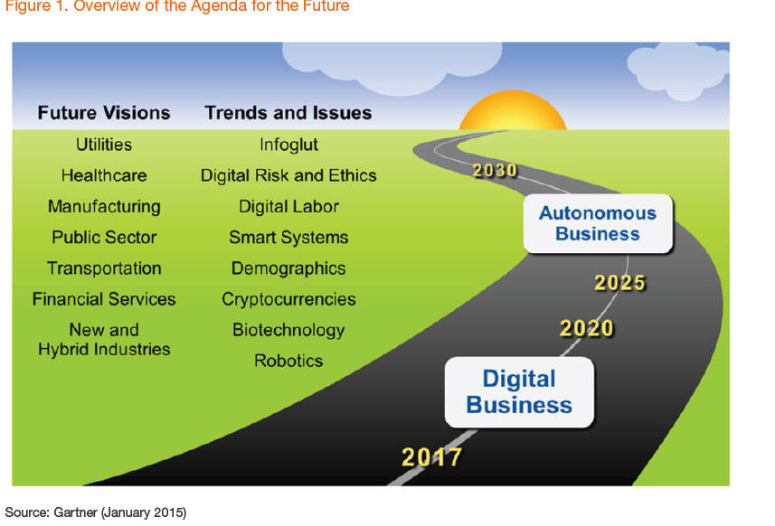
Agenda Overview for the Agenda for the Future, 2015..30

Slide 17
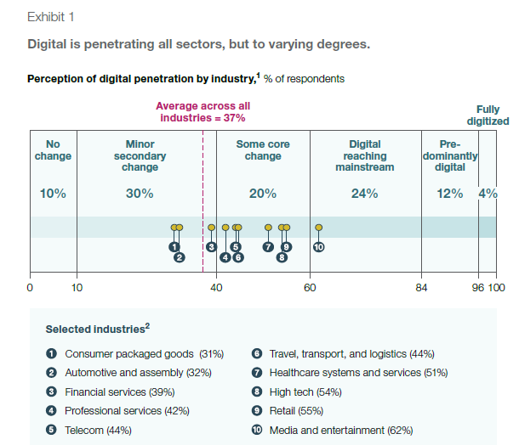
The case for digital reinvention; Mckinsey

Slide 18
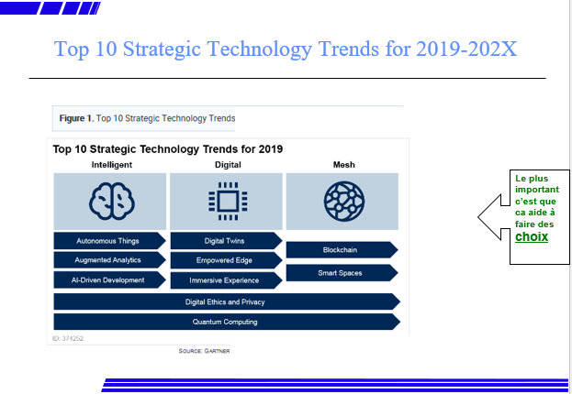

Slide 19
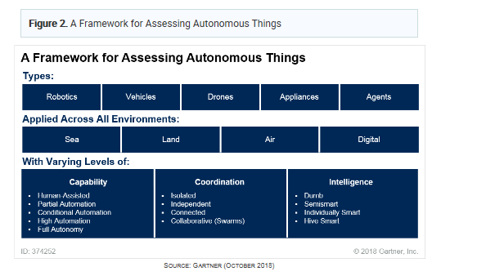

Slide 20
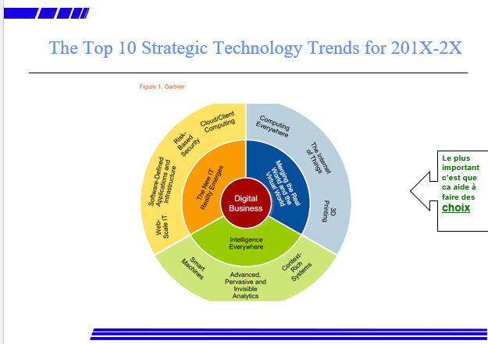

Slide 21
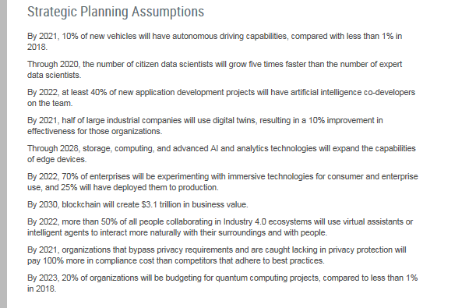
Strategic Planning Assumptions (Gartner 202X)

Slide 22
Le plus important c’est que ca aide à faire des choix
Strategic Planning Assumptions (Gartner 202X)
By 2019, digital business will require 50% fewer business process workers and 500% more key digital business jobs, compared with traditional models.
By 20XX, a significant and disruptive digital business will be launched that was conceived by a computer algorithm. Remote control (tower watch)
By 2019, the total cost of ownership for business operations will be reduced by 30% through smart machines and industrialized services. Automation + BI +Big DATA
By 2020, developed world life expectancy will increase by a half-year, due to the widespread adoption of wireless health monitoring technology. Mobile application
By 20XX, more than $2 billion in online shopping will be performed exclusively by mobile digital assistants.
By 20XX, U.S. customers' mobile engagement behavior will drive mobile commerce revenue in the U.S. to 50% of U.S. digital commerce revenue.
By 20XX, 70% of successful digital business models will rely on deliberately unstable processes designed to shift as customers' needs shift.
By 20XX, 50% of consumer product investments will be redirected to customer experience innovations.
By 2019, nearly 20% of durable goods "e-tailers" will use 3D printing to create personalized product offerings.
By 2020, retail businesses that use targeted messaging in combination with internal positioning systems will see a 5% increase in sales.

Slide 23
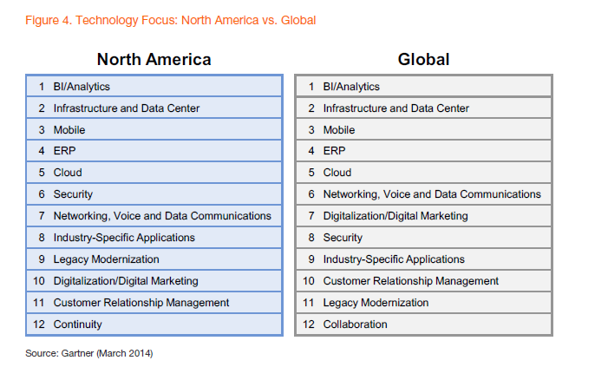
Le plus important c’est que ça aide à faire des choix. Supporter des choix stratégiques

Slide 24
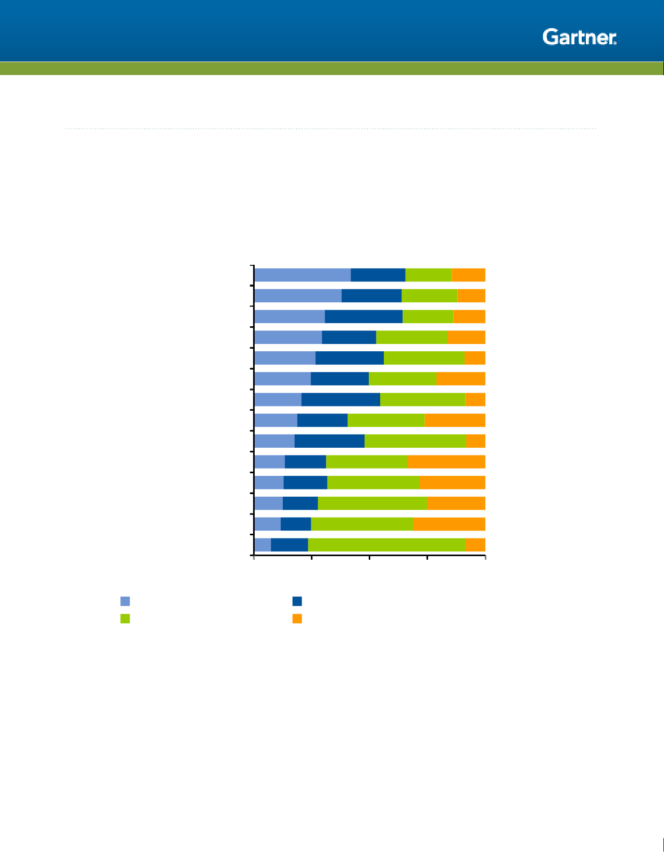
This research note is restricted to the personal use of michel.martel@riotinto.com
CIOs recognize that new skills and approaches are needed in order for the IT
organization to deliver business value
A challenge for CIOs and enterprise architects is how to build the competencies needed to support
these new roles of hunting and harvesting (Figure 8). Over 50% of CIOs report that a lack of EA,
business intelligence and analytics, and security and risk management talent is having a negative
impact on their organizations. Within EA in particular, there is an increasing emphasis on business
and information architecture skills, which are often hard to find (see "Make Enterprise Architect a
Career, Not Just a Job Title").
Manque de compétences
Figure 8. Building the Talent to Hunt and Harvest
Enterprise Architecture
Business Intelligence and Analytics
Security and Risk Management
IT Strategy and Planning
Application Development
Business Process Management
Program and Project Management
Business Relationship Management
Infrastructure and Operations
Sourcing Management
Vendor Management
IT Finance
IT Human Resources
Customer Service/Help Desk
0%
25%50%75%
Distribution of Responses
100%
Negative Impact on Business
Short-Term Impact on Business
Sufficient Skills
Do Not Know
Source: Gartner (July 2013)
We recently spoke to the CIO of an insurance company based in Asia/Pacific. The company's
strategy is to create a set of interrelated insurance products, with a multichannel delivery model as
a basis for expanding across the region. The IT organization and EA team had, up to this point,
been quite traditional, with the EA team focusing largely on technical architecture. The CIO wanted
EA to focus on business and information architecture, and so was recruiting an individual into the
chief architect role from a large management consultancy, as well as many new EA team members
Gartner, Inc. | G00252281
Page 11 of 14
This research note is restricted to the personal use of michel.martel@riotinto.com

Slide 25
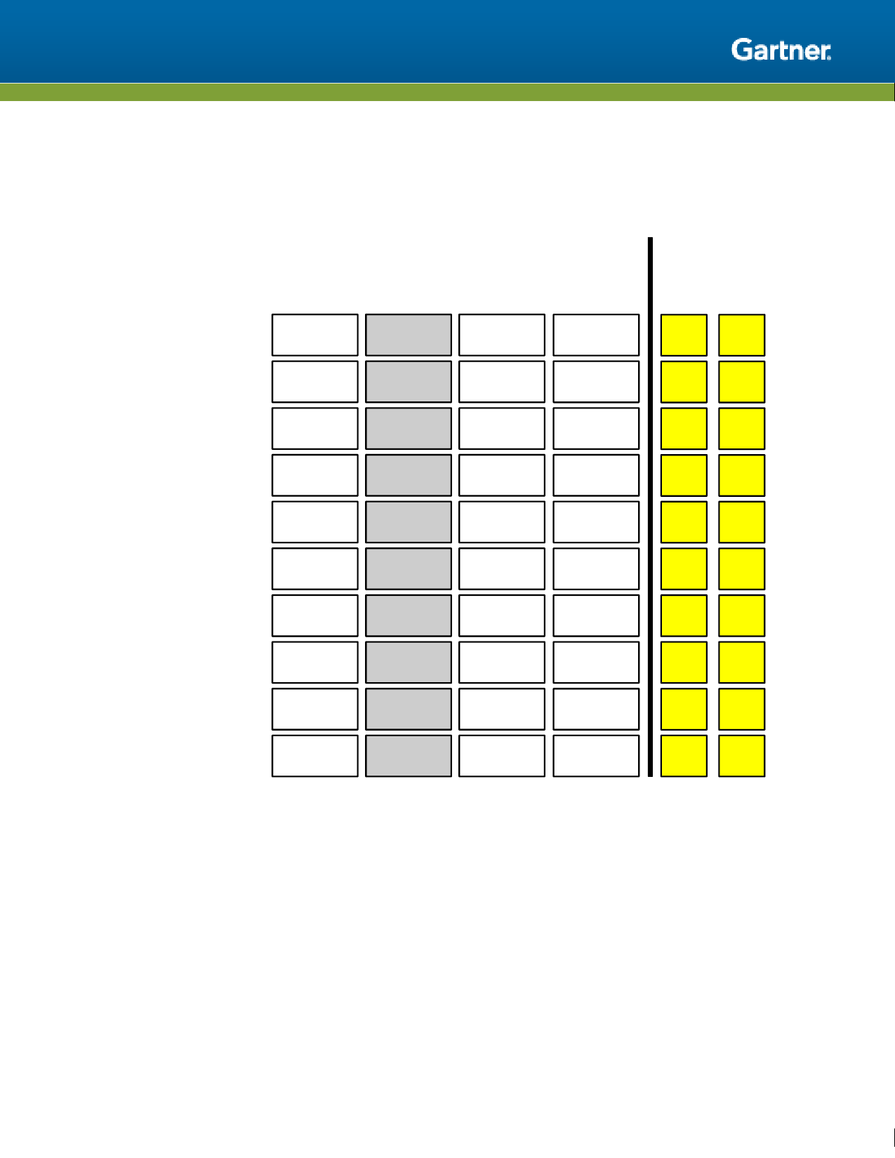
This research note is restricted to the personal use of michel.martel@riotinto.com
from roles as business analysts within the company. This would give the EA team the business and
behavioral profile the CIO was looking for. As this case illustrates, new competencies will be
required as the IT organization adapts (see Figure 9).
Figure 9. Changes to the IT Organization's Role
Leadership
Role
Participation No Change in Participation
Increasing Participation Decreasing
Does Not
Apply
Past 3
Years
Next 3
Years
Business Strategy
Formulation
41%
54%
3%
2%
14%
26%
Business Strategy
Execution
38%
56%
5%
1%
19%
34%
Digital Business and
Digital Channels
29%
50%
8%
13%
18%
32%
Business Innovation
41%
52%
5%
2%
22%
41%
Product or Service
Design and Development
35%
52%
6%
7%
14%
25%
Business Process
Analysis and Management
36%
56%
7%
1%
28%
44%
Enterprise Change
Execution
29%
62%
8%
1%
26%
38%
Enterprise Program
Project Management
27%
66%
6%
1%
41%
51%
Mergers and Acquisitions
18%
47%
6%
29%
8%
12%
Postmerger Integration
15%
46%
9%
30%
18%
24%
Source: Gartner (July 2013)
Key EA competencies include business strategy formulation, business innovation, and business
strategy execution, as well as behavioral skills — such as the ability to establish and maintain good
working relationships with a wide range of stakeholders. This represents a significant opportunity for
enterprise architects to make their role more strategic, by focusing on business growth and
innovation, and by using business-outcome-driven EA to support these areas. This opportunity
should not be missed, as it's unlikely to come along again.
These competencies must be combined with more-agile approaches to innovation, such as being
able to run experiments. The ability to identify an opportunity, quickly set it up and pilot it, assess
the results and decide to expand into another cycle or kill off is needed to support both Hunting and
Harvesting. Enterprise architecture can support this by providing the enabling and diagnostics
Page 12 of 14
Gartner, Inc. | G00252281
This research note is restricted to the personal use of michel.martel@riotinto.com

Slide 26
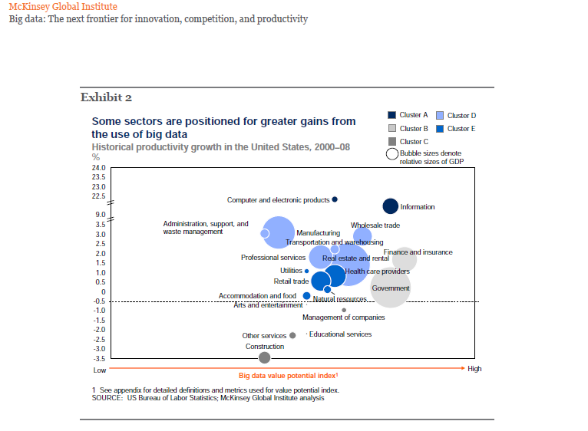
Du physique à L’information

Slide 27
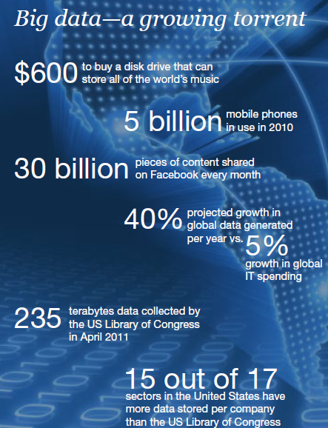
2. Big data: The next frontier for innovation, competition and productivity Big data will become a key basis of competition, underpinning new waves of productivity growth, innovation, and consumer surplus—as long as the right policies and enablers are in place. The accompanying interactive examines the state of digital data and the value that can potentially be unlocked. Mckinsey 201X..2X

Slide 28

7
McKinsey Quarterly; Big data
5
Experimentation and big data
Could the enterprise become a full-time
Web-based companies, such as Amazon.com, eBay,
laboratory? What if you could analyze every
and Google, have been early leaders, testing fac-
transaction, capture insights from every customer
tors that drive performance—from where to place
interaction, and didn’t have to wait for months
buttons on a Web page to the sequence of content
to get data from the field? What if . . . ? Data are
displayed—to determine what will increase sales
flooding in at rates never seen before—doubling
and user engagement. Financial institutions are
every 18 months—as a result of greater access
active experimenters as well. Capital One, which
to customer data from public, proprietary, and
was early to the game, continues to refine its
purchased sources, as well as new information
methods for segmenting credit card customers and
gathered from Web communities and newly
for tailoring products to individual risk profiles.
deployed smart assets. These trends are broadly
According to Nigel Morris, one of Capital One’s
known as “big data.” Technology for capturing
cofounders, the company’s multifunctional teams
and analyzing information is widely available at
of financial analysts, IT specialists, and marketers
ever-lower price points. But many companies are
conduct more than 65,000 tests each year, experi-
taking data use to new levels, using IT to support
menting with combinations of market segments
rigorous, constant business experimentation that
and new products.
guides decisions and to test new products, business
models, and innovations in customer experience.
Companies selling physical products are also using
In some cases, the new approaches help companies
big data for rigorous experimentation. The abil-
make decisions in real time. This trend has the
ity to marshal customer data has kept Tesco, for
potential to drive a radical transformation in
example, in the ranks of leading UK grocers. This
research, innovation, and marketing.

Slide 29
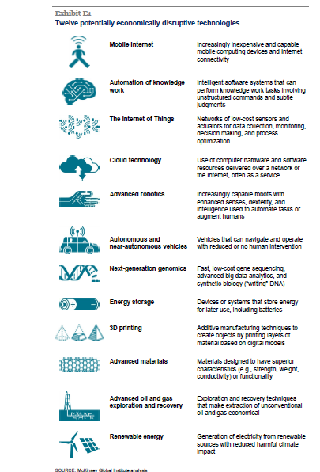
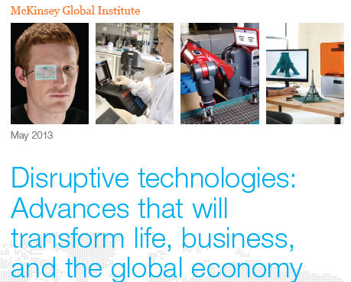
Perturber l’évolution Technologique

Slide 30
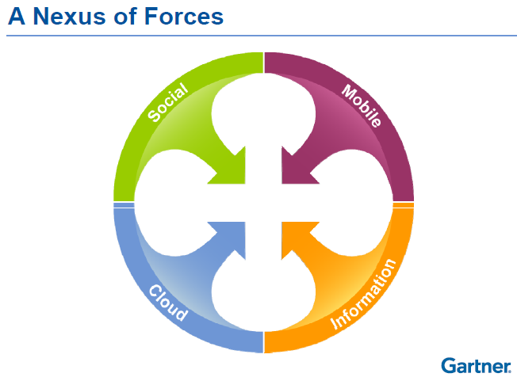
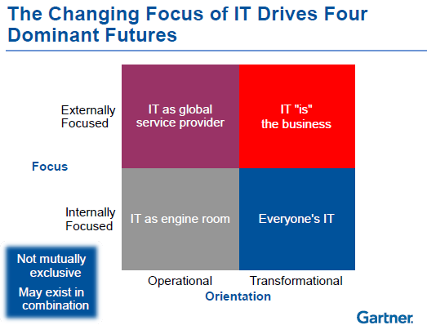
Gartner; the Nexus forces; Top Strategic Technology Trends ;The Four Futures for IT

Slide 31
Nous venons de faire de IA en se documentant sur un sujet pour mieux prendre des décisions dans le futur…..Les meilleurs

Slide 32
Exercice en classe no 1 (Individuel)
Selon vous
Que signifie l’Intelligence d’affaires pour vous maintenant
Quel sont les principaux enjeux relié à la mise en place de l’Intelligence d’affaires

Slide 33
Atelier Enjeux (top 2); en équipe
Avec CHATGPT
1-
2-
Sans CHATGPT
1-
2-
ENJEU: Ce que l'on peut gagner ou perdre, une entreprise.
Selon CHATGPT: facteur critique de réusiste.

Slide 34
Atelier Défi BI (top 2); en équipe
1-
2-

Slide 35
Intelligence d’affaires
L’analyse informationnelle (tableau de bord)
La veille stratégique, technologique et concurrentiel
La gestion de la connaissance
Automatisation des processus ( algorithme)
+ dernièrement le phénomème Big DATA
+ dernièrement l’Intelligence artificielle

Slide 36
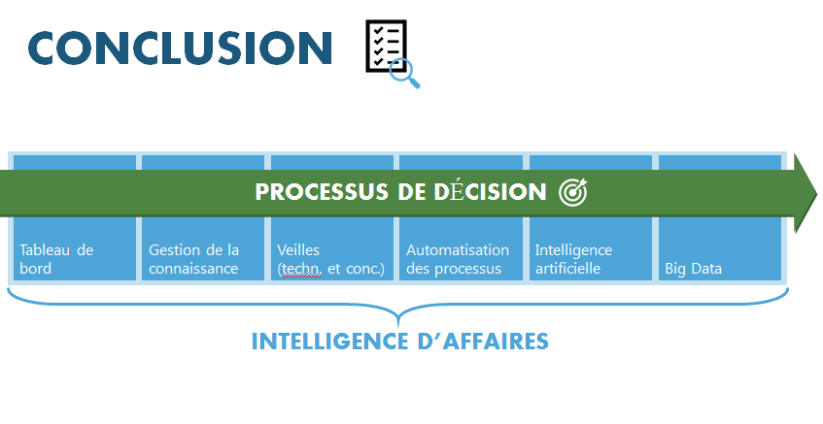

Slide 37
Conclusion (suite)
BI le plus important c’est d’acquérir les principes et les processus pour développer la pensée stratégique et l’intelligences d’affaires versus le contenu qui change vite…
BI faut comprendre:
Base de la prise de décision:
 | Informations du Passé de l’entreprise | InformationsPrésent de l’entreprise | Informations futur de l’entreprise
BI | 20 % | 40% | 40%
Stratégie | 10 % | 30 % | 60%
Émotion (feeling) / Expérience / Fait / Analytic (modèle de statitisque avancé)

Slide 38
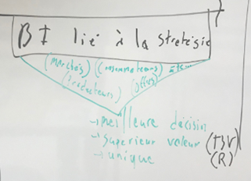

Slide 39
Le benchmark
Le benchmark en affaires est une démarche qui consiste à comparer les performances, les processus ou les pratiques d'une entreprise avec ceux d'autres entreprises ou organismes considérés comme des références dans un domaine particulier. L'objectif est d'identifier les écarts de performance, de comprendre les meilleures pratiques et de s'inspirer de ces dernières pour améliorer les résultats de l'entreprise.
Le benchmark peut être utilisé dans plusieurs contextes, comme l'efficacité des processus, la satisfaction des clients, les coûts opérationnels ou l'innovation. Il peut être interne (comparaison entre différentes divisions ou filiales d'une même entreprise) ou externe (comparaison avec des concurrents directs ou des entreprises leaders dans d'autres secteurs).

Slide 40
Le benchmark; Exemple concret :
Prenons l'exemple de Toyota dans le secteur automobile.
Toyota est réputée pour avoir utilisé le benchmark pour perfectionner son système de production, connu sous le nom de "Toyota Production System" (TPS). L'entreprise a analysé les pratiques d'autres leaders industriels pour optimiser ses propres processus. Par exemple, elle s'est inspirée des supermarchés américains pour concevoir le système "Juste-à-temps" (JIT), où les matériaux et les pièces sont approvisionnés uniquement en fonction des besoins immédiats de la production. Cela a permis à Toyota de réduire les gaspillages, d'améliorer l'efficacité et de devenir un modèle pour d'autres entreprises.

Slide 41
Benchmark
KPI | Q1 | Q2 | Q3 | Q4
Tonne/employé
Energie/tonne Hr supp./emp.
$ entretien/tonne
$ approv./tonne

Slide 42
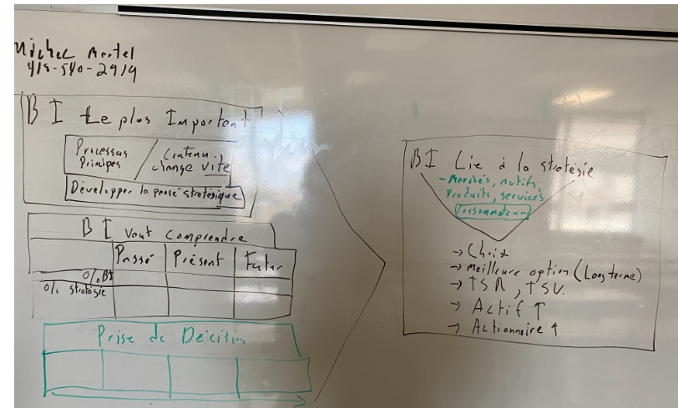

Slide 43



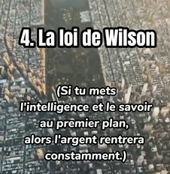

LOIS Question pour vous laquelle des lois suivantes a un lien direct avec le BI ?

